Slide 1
Agile@Scale KPI Metrics Explained
v1.5.0
February 2019

Slide 2
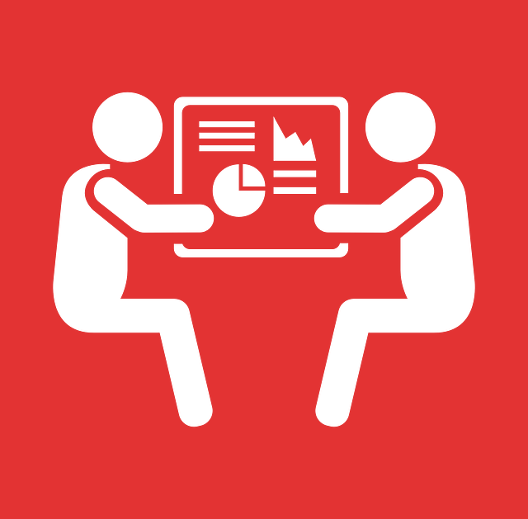
Why Do We Need KPI Metrics?
We have to show to the wider company how our teams are doing and show the improvements we’re making in our Agile journey.
We can use the metrics to help us improve our productivity. The metrics will never be used to punish a team. We know all teams are doing their best with the knowledge and capabilities they have at the time.
The metrics will be used to support the improvements and help teams succeed in there mission of putting the customer first.

Slide 3
How the Metrics Will Be Used
The education is important in the usage and for the success in our KPI Metrics the key message:
The KPI Metrics are to be used to help the teams improve NOT to be used to punish or whip teams.
Tell me how you measure me and I will tell you how I will behave. If you measure me in an illogical way… do not complain about illogical behaviour…
Eli Goldratt
Whenever there is fear, you will get wrong figures.
W. Edwards Deming
The big problems are where people don't realise they have one in the first place.
W. Edwards Deming

Slide 4
KPI Metrics Categories
ROI
These ensure we’re building the right thing from the business point of view. As it currently stands these KPI Metrics are to be defined. Agile Coaches will be working with teams to help define this over Q4 2018
Efficiency
How fast are we going, how much value are we releasing to our customers.
Quality
Are our products stable, are they of the highest quality with minimum cutting of corners to ensure we have sustainable products.
ROI
Quality
Building the right thing
Building the thing right
Building the thing fast
Efficiency

Slide 5
KPI Metrics Categories
Efficiency
When we’re looking at how efficient we are, we need to see where we are improving and where our bottlenecks have moved to. This will help us ensure that we are getting the must from our teams, with as little waste as possible in the flow.
When issues do happen in production, we need to know how efficient we are at getting the service back for our customers so they can start placing bets again.
Lead / Cycle / Flow Times
Deployment Frequency
MTTR (Mean Time To Restore)
Quality
If we optimised only efficiency without ensuring quality we would be doing a disservice to our stakeholders and customers. Every time we push out an update to our products we should be ensuring we’re improving the quality.
When releases happen we want them to happen more often, and for this to work we need to ensure that are releases are small and often with minimal disruptions.
Number of Bugs
Number of Technical Debt
CFR (Change Failure Rate )

Slide 6
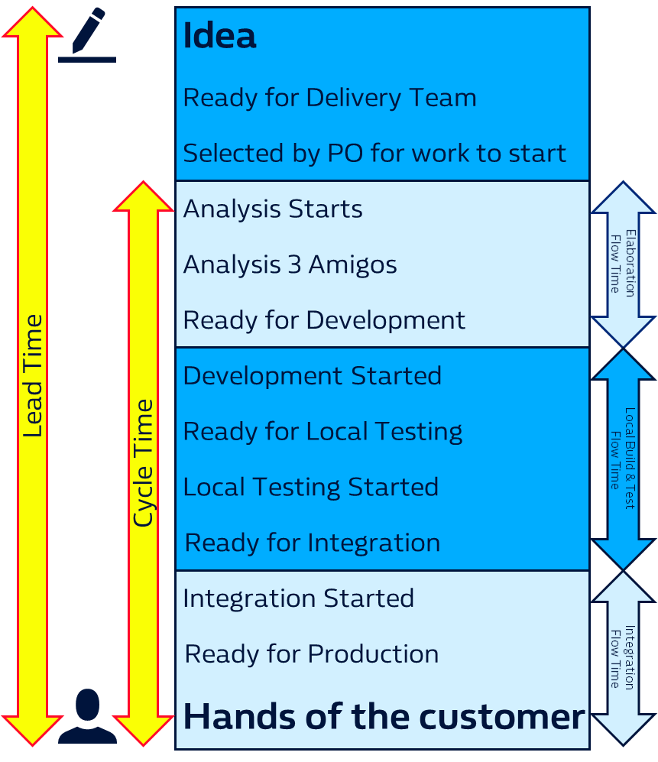
Lead & Cycle Times
Lead time clock starts when the request is made and ends in the Hands of the Customer.
Cycle time clock starts when work begins on the request and ends when the item is in the Hands of the Customer.
A decrease in Lead Time and Cycle Time show we are delivering items quicker to the Hands of the Customer. When the Lead Time and Cycle Time closely match we show that our hand off from the Idea to the Hands of the Customer is reduced greatly.

Slide 7
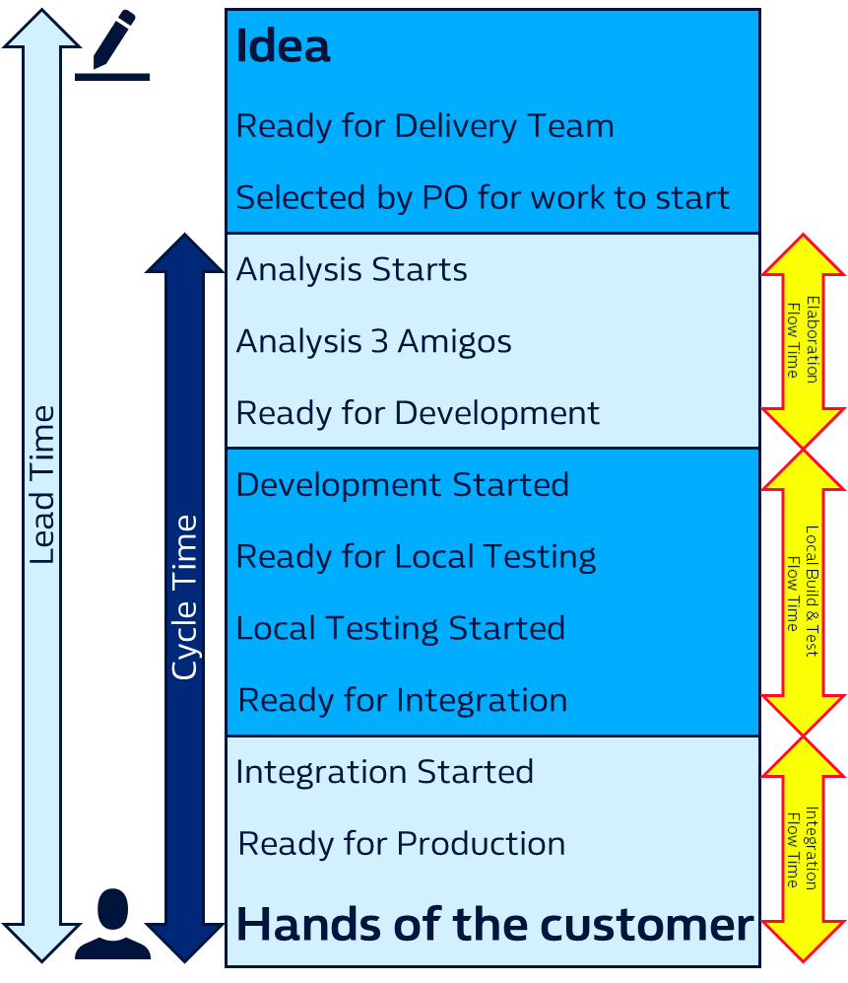
Flow Times
We are using the term Flow Times to explain the sections of our value stream when work is being prepared for teams, while the teams are working on it and then while the teams are deploying and testing into environments of which they don’t have full control of, through to production and the Hands of the Customer.
The reason we have split Cycle Time further, is to allow us to view the improvements we’re making in each area of the value stream. The first being with the Product Team, the second with Development Team and the third of the Development Team & IT Operations working together.
Elaboration Flow Time
Local Build & Test Flow Time
Integration Flow Time

Slide 8
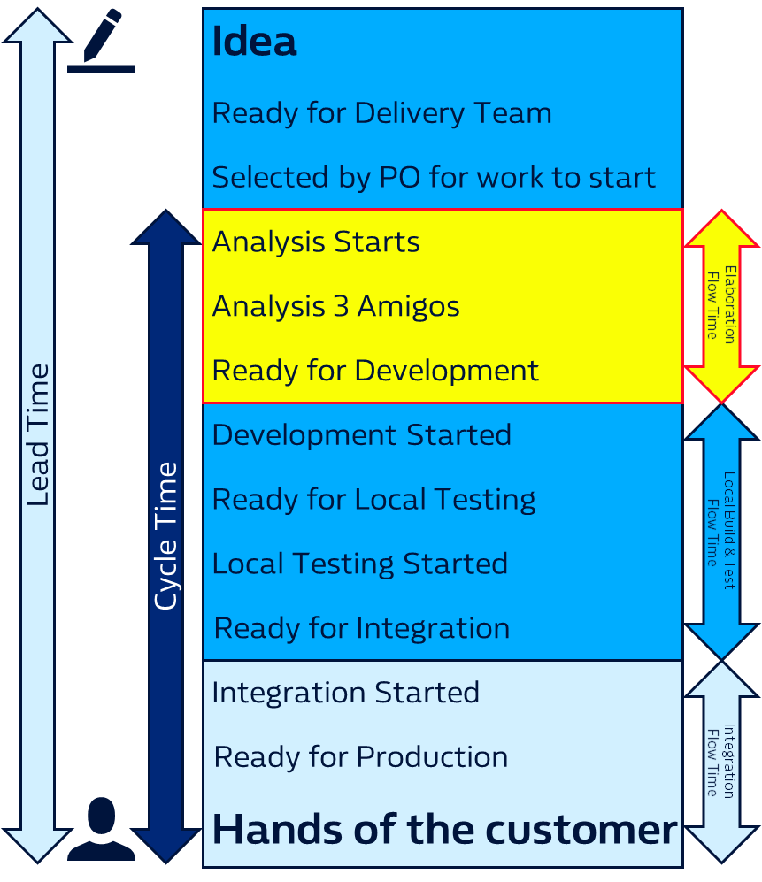
Elaboration Flow Time
From the moment an Idea has work started on it to get it Ready for Development is the start of the Elaboration Time.
Sometimes priorities of other work will hold this up, but using this data and the narrative with it will highlight the waste we have in our flows.
We need to understand from the moment a piece of work is selected to work on how long does it take us to get it Ready for Development. We need to understand the issues and blockers that stop this being a smooth easy process for our Product Teams.
Using this data will help us improve our work selection and highlight the bottlenecks we have early in our flows.

Slide 9
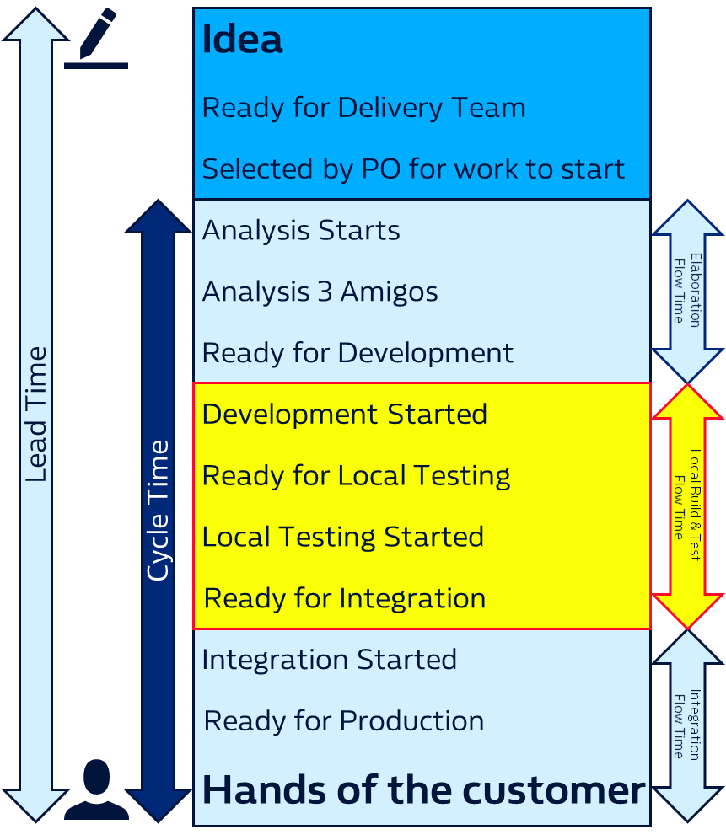
Local Build & Test Flow Time
Once an Idea is Ready for Development we need to track the time it takes the team to Locally Build & Test.
We indicate this as local as this should be an environment the development team have full control over and don’t need to rely on any other team.
We understand some team may like to have this as their Definition of Sprint Done and this is fine. They would need to have a Definition of Done for the Hands of the Customer also known as definition of done done.
These are the Flow Time gates only, team sprints can include any potion of the value stream. The reporting of the flow times will be at the points indicated here.

Slide 10
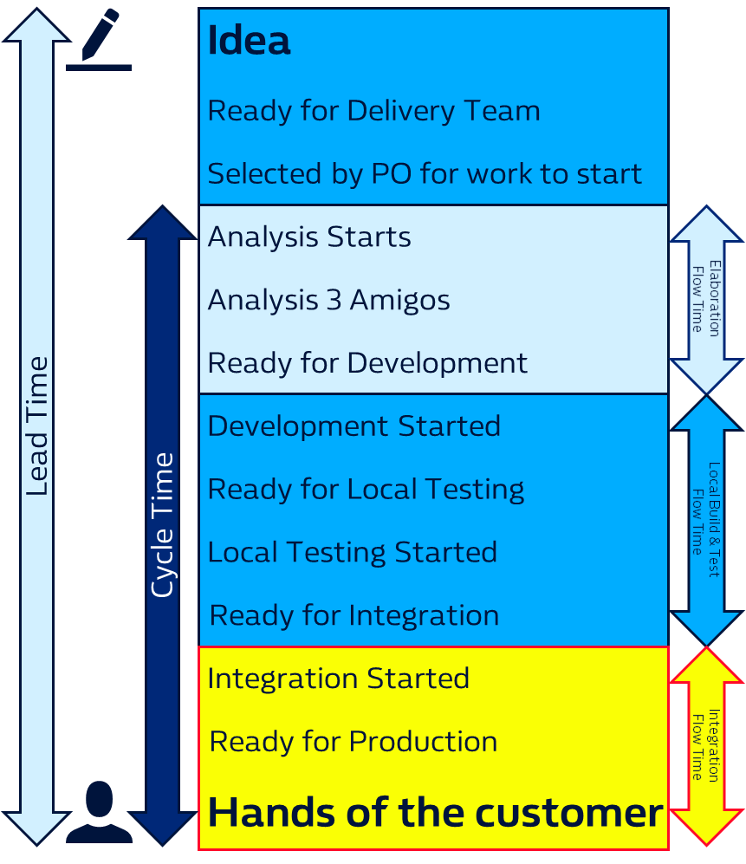
Integration Flow Time
When the Local Build and Test is complete this is the first stage that teams start to work in environments in which they don’t have full control of. They may have a reliance on other service created by another team and on occasions these services fail and may take time for them to be resolved.
In measuring the Integration Flow Time we are able to track our improvements in the DevOps culture of teams.
In addition with the adoption of AWS in teams we should see the reliance on the interactions in teams earlier in the value stream create a stable integration platforms for all teams.

Slide 11
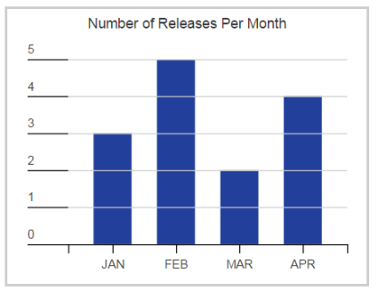
Deployment Frequency
DevOps practices make frequent or continuous delivery possible; large, high-traffic web sites and cloud-based services make it a necessity.
With fast feedback and small-batch development, updated software can be deployed every few days, or even several times per day.
In a DevOps environment, deployment frequency can be a direct or indirect measure of response time, team cohesiveness, developer capabilities, development tool effectiveness, and overall DevOps team efficiency.

Slide 12

MTTR (Mean Time To Recovery)
This is the time from a failure to recovery from that failure. It’s generally a good measure of team capabilities, it should show an overall decrease over time (allowing for occasional longer recovery times when the team encounters a technically unfamiliar problem).
MTTR can also be affected by such things as code (or platform) complexity, the number of new features being implemented, and changes in the operating environment.
Based on these metrics, the ideal DevOps team would produce frequent, rapid deployments with a low (and declining) failure rate and a short (and shrinking) recovery time.

Slide 13

Number of Bugs
If we’re increasing the speed it takes us to delivery products to the Hands of the Customer we have to ensure that the quality of our products doesn’t reduce.
We would like to track the number of bugs in our products that haven’t been resolved yet.
We understand over time there will be a number of bugs that have been open for over 6-12 months. These would be identified and archived and this note made on the reporting metrics to indicate the archiving.

Slide 14

Number of Technical Debt
Technical Debt is a subjective term. William Hill has a clear definition of this and the link is below.
We require teams to have a honest account of their Technical Debt and this can be lack of documentation, out dated versions of components or and not limited to lack of automation testing.
We require teams to raise these in their backlogs and work with their product teams to prioritise these items to improve the quality of our products.
Not paying back Technical Debt is like a financial debt, you’ll go bankrupt and need to start again if you don’t service it.
We have a clear definition of Technical Debt here: Communicating Technical Debt

Slide 15
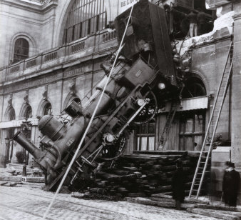
CFR (Change Failure Rate)
One of the main goals of DevOps is to turn rapid, frequent deployments into an everyday affair.
Needless to say, in order for such deployments to have value, the failure rate must be low. It should, in fact, decrease over time, as the experience and capabilities of the DevOps teams increase.
An increasing failure rate, or one that is high and does not go down over time, is a good indication of problems in the overall DevOps process.

Slide 16
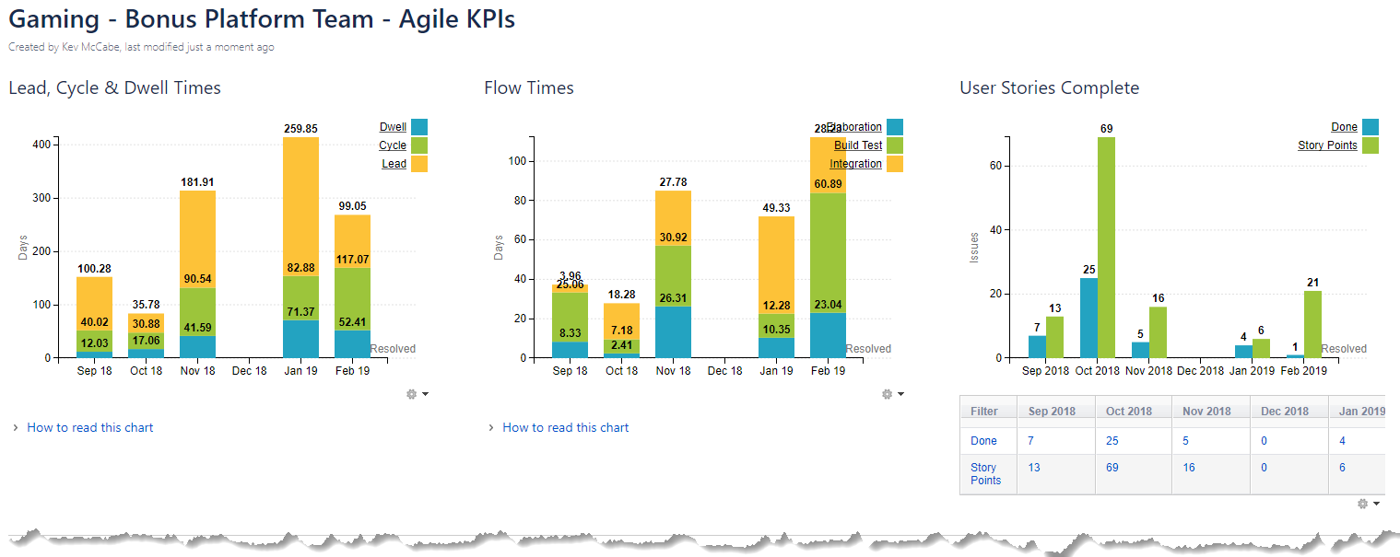
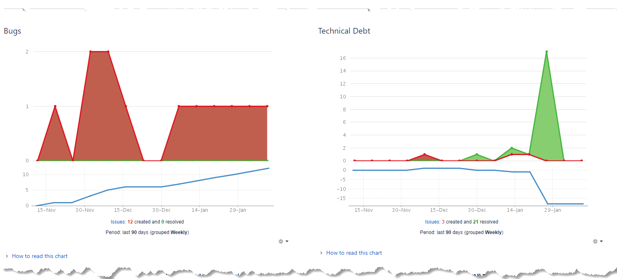
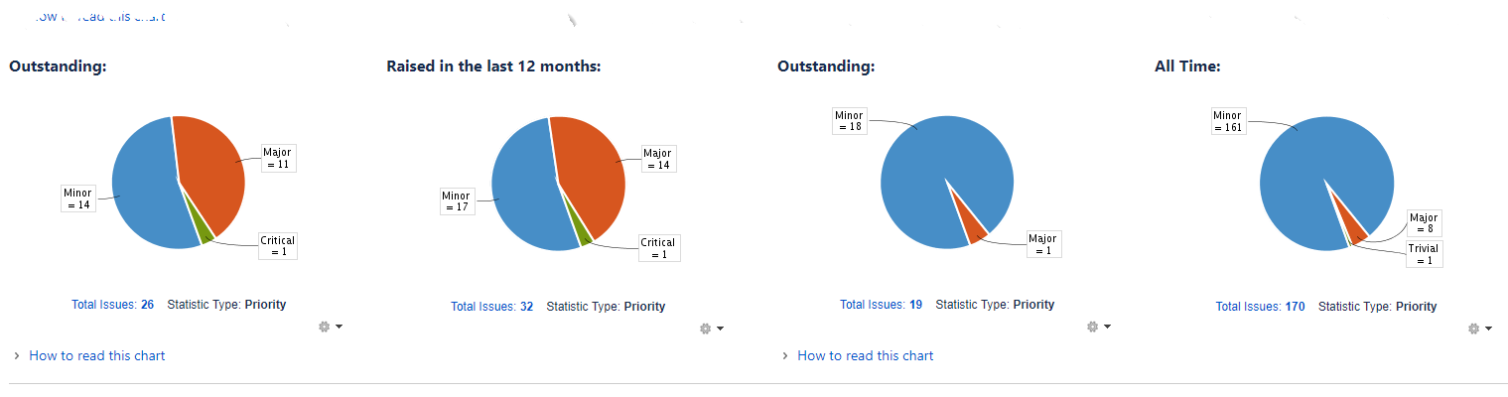
Dashboards

Slide 17
Lead Time
Idea
Ready for Delivery Team
Selected by PO for work to start
Cycle Time
Analysis Starts
Elaboration Flow Time
Analysis 3 Amigos
Ready for Development
Development Started
Local Build & Test Flow Time
Ready for Local Testing
Local Testing Started
Ready for Integration
Integration Started
Integration Flow Time
Ready for Production
Hands of the customer

